Slide 1
Applied Statistics
Sheela S, Assistant Professor
Department of CSE
GAT

Slide 2
Agenda

Slide 3
Random variable
●The action of rolling a die is called a random experiment
●The set of possible outcomes of an experiment is called the Sample Space and it is denoted by Ω
●Possible outcomes for this experiment are: 1, 2, 3, 4, 5, and 6
●A Random Variable is a function defined from the sample space to real numbers

Slide 4
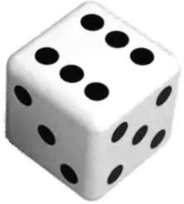
Random variable
●The usual notation used for a random variable is ‘X’. However, other capital letters like
U, V, or Z can be used
●Let us observe the experiment of number appeared on the die. We define our random variable as
X: the number observed
X takes values 1, 2, 3, 4, 5, and 6.
Hence Ω = {1, 2, 3, 4, 5, 6}

Slide 5
Random variable
Question:
Suppose you are the owner of a grocery shop. You wish to improve the shopping experience of your customers, by easing their payment methods and ensuring that whichever products they demand are available in the shop.
Now collect the data for:
● mode of payment
● bill amount
Can you describe the nature of the data collected?

Slide 6
Random variable
Solution:
The nature of the data collected is as follows:
●mode of payment: the data takes two distinct values Cashless payment and Cash payment
●bill amount: It takes values such as $11.45, $32, $8.

Slide 7
Random variable
Eg: The mode of payment
- cash, mobile wallet, card,
bank transfer
Eg: The bill amount

Slide 8
Discrete random variable
●A discrete random variable takes discrete values that is value from the set of whole numbers only or a set of categories
●A discrete random variable can either take finite or countably values
●The possible outcomes can be listed effectively

Slide 9
Discrete random variable
Examples
●Let V : The number of pages in a document Ω = {1, 2, 3,. }
●Let X: The number of views for a you tube video
Ω = {0, 1, 2, 3,. }
●Let U: The size of the shirt available Ω = {XS, S, M, L, XL}
Note that random variables take values only from the set of whole numbers and are thus discrete random variables

Slide 10
Continuous random variable
●A continuous random variable takes infinitely many values (within a specified range)
●It can either take an uncountably infinite set of values or values in a given interval
Examples:
●Let Z: The income of a person
Ω = (0, maximum income of a person)
●Let V: The level of water in a dam
Ω = (0, height of the dam)
Note that random variables Z and V take values from a range and are thus continuous
random variables

Slide 11

Identify whether the variable is discrete or continuous random variable.
1.Number of children in a family
2.The Depth of drilling to find oil
3.Defective Light bulbs in a box of ten
4.Amount of sugar in an orange
5.The time required to run a mile

Slide 12
Probability Distributions

Slide 13
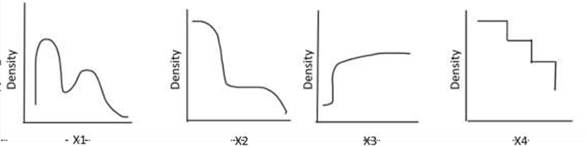
Distribution of the data
The distribution is a summary of the frequency of values taken by a random variable
The distribution of the data gives information on the shape and spread of the data
On plotting the histogram or a frequency curve for a variable, we actually look at how the data is distributed over its range

Slide 14
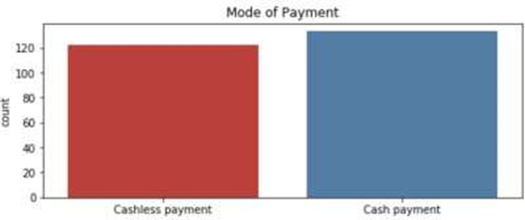
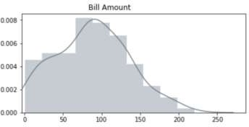
Probability distribution
Recall the example of data collection at the store. The data was collected for the mode of payment and the bill amount.
If we represent the data will have the following figures:

Slide 15
Need for probability distribution
The statistical tests have assumptions based on the probability distributions that are needed to be verified before using the test.
Once the distribution of the data is known, the descriptive statistics of the data is readily available.
For instance, if the stock trader can determine the probability distribution of a particular stock, then the trader can estimate the potential expected returns that may yield in the future.

Slide 16
Probability distribution
●A probability distribution is a list of all the possible outcomes of a random variable along with their corresponding probability of occurrence
●P(X=x) refers to the probability that the random variable X takes a particular value x
●A probability distribution is defined by its
probability mass function (p.m.f) for a discrete random variable
probability density function (p.d.f) for a continuous random variable

Slide 17
Probability distribution
Discrete Variable Continuous Variable

Slide 18
The PMF and PDF difference
The mathematical difference between a discrete distribution and a continuous distribution is:
The discrete distribution is defined by the probability mass function (pmf) which is the probability at a particular point
The continuous distribution is defined by the probability density function (pdf) which is the integration over it’s range

Slide 19
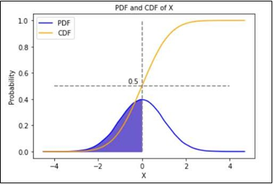
Cumulative distribution function (c.d.f.)
The advantage of the CDF is that it can be defined for any kind of random variable (discrete, continuous, and mixed).
It gives the cumulative distribution function i.e P(X ≤ x)
Denoted by F(x)
That is, F(x) = P(X ≤ x)
The area of shaded region is 0.5

Slide 20
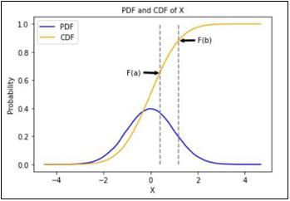
Properties of c.d.f.
0 ≤ F(x) ≤ 1 since it is a probability
An increasing function or monotonically non- decreasing function
F(-∞) = 0 and F(∞) = 1
For any two numbers a and b such that a < b,
the probability is computed as:
P(a ≤ X ≤ b) = F(b) - F(a)

Slide 21
Mathematical expectation of a random variable
It is the mathematical mean of a random variable
It is the central location
Also known as expected value
Denoted by µ
For a probability distribution, it is µ = ∑ x. f(x) Where f(x) is the probability mass function

Slide 22
Variance of a random variable
It is the mathematical mean of squares of deviations taken from the mean
Denoted by σ2
For a probability distribution, it is σ2 = ∑ (x - µ)2. f(x) where f(x) is the probability mass function

Slide 23
Probability distributions

Slide 24
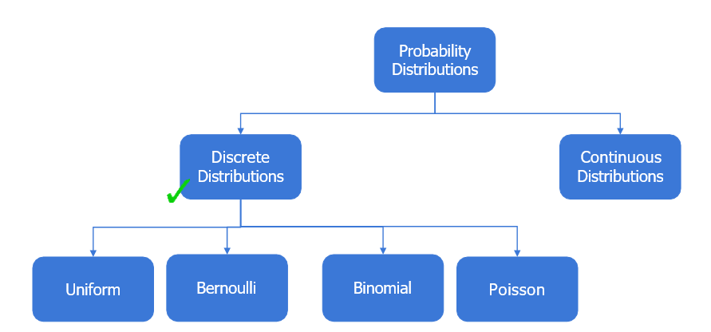
Probability distributions

Slide 25
Uniform Distribution
Any situation in which every outcome in a sample space is equally likely will use a uniform distribution.
uniform probability model. • a model in which every outcome has equal probability.
One example of this in a discrete case is rolling a single standard die. There are a total of six sides of the die, and each side has the same probability of being rolled face up

Slide 26
Real-Life Examples of the Uniform Distribution
Example 1: Guessing a Birthday: If you walked up to a random person on the street, the probability that their birthday falls on a given date would follow a uniform distribution because each day of the year is equally likely to be their birthday.
Example 2: Rolling a Die:If you roll a die one time, the probability that it falls on a number between 1 and 6 follows a uniform distribution because each number is equally likely to occur.

Slide 27
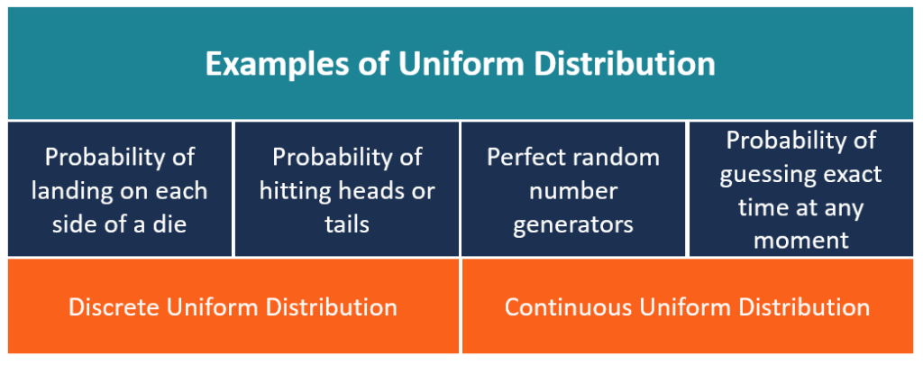

Slide 28
Binomial Distribution
The binomial distribution is the sum of a series of multiple independent and identically distributed Bernoulli trials.
In a Bernoulli trial, the experiment is said to be random and can only have two possible outcomes: success or failure.

Slide 29
Binomial distribution

Slide 30
Binomial distribution

Slide 31
Binomial distribution

Slide 32
Binomial distribution

Slide 33

Binomial distribution
●It is based on the Bernoulli distribution
●A discrete random variable (X) taking values 0,1,2,...,n follows a binomial distribution if
the p.m.f. of X is given as:
●X follows binomial distribution with parameters n and p, i.e X ~ Binomial(n,p)
●p is the probability of success, q is the probability of failure and n is the number of
times the experiment is conducted

Slide 34
Binomial distribution

Slide 35
Real-Life Examples of the Binomial Distribution
Example 1: Number of Side Effects from Medications: Medical professionals use the binomial distribution to model the probability that a certain number of patients will experience side effects as a result of taking new medications.
Example 2: Number of Fraud Transactions: Banks use the binomial distribution to model the probability that a certain number of credit card transactions are fraudulent.
Example 3: Number of Spam Emails per Day: Email companies use the binomial distribution to model the probability that a certain number of spam emails land in an inbox per day.
Example 5: Shopping Returns per Week
Retail stores use the binomial distribution to model the probability that they receive a certain number of shopping returns each week.

Slide 36
Binomial distribution

Slide 37
Question:
In a shooting academy, data was collected on the precision shooting of a student. From 15 shots fired 11 were on target. Considering the same student, what is the probability that out of 50 shots fired, exactly 35 will hit the target?
P(X=x) = nCx px (q)n-x.

Slide 38
Solution:
Let X denote the shot fired hits the target
The probability of success, i.e. is hitting the target is 11/15
Thus, p = 0.733
To find: the probability that out of 50 shots fired, 35 will hit the target Here, n = 50
We have X~Binomial(50, 0.733)
The required probability is P(X = 35)
P(X = x) = nCx px (1-p)n-x
P(X = 35) = 50C35 (0.733)35 (1-0.733)50-35
= 50C35 (0.733)35 (0.267)15
= 0.107
Thus, the probability that out of 50 shots fired, exactly 35 will hit the target is 0.107

Slide 39
Binomial distribution

Slide 40
Poisson distribution

Slide 41
Example 1: Calls per Hour at a Call Center
Call centers use the Poisson distribution to model the number of expected calls per hour that they’ll receive so they know how many call center reps to keep on staff.
For example, suppose a given call center receives 10 calls per hour. We can use a Poisson distribution calculator to find the probability that a call center receives 0, 1, 2, 3 … calls in a given hour:
P(X = 0 calls) = 0.00005
P(X = 1 call) = 0.00045
P(X = 2 calls) = 0.00227
This gives call center managers an idea of how many calls they’re likely to receive per hour and enables them to manage employee schedules based on the number of expected calls.

Slide 42
Example 2: Number of Arrivals at a Restaurant
Restaurants use the Poisson distribution to model the number of expected customers that will arrive at the restaurant per day.
For example, suppose a given restaurant receives an average of 100 customers per day. We can use the Poisson distribution calculator to find the probability that the restaurant receives more than a certain number of customers:
P(X > 110 customers) = 0.14714
P(X > 120 customers) = 0.02267
P(X > 130 customers) = 0.00171
This gives restaurant managers an idea of the likelihood that they’ll receive more than a certain number of customers in a given day.

Slide 43
Example 3: Number of Website Visitors per Hour
Website hosting companies use the Poisson distribution to model the number of expected visitors per hour that websites will receive.
For example, suppose a given website receives an average of 20 visitors per hour. We can use the Poisson distribution calculator to find the probability that the website receives more than a certain number of visitors in a given hour:
P(X > 25 visitors) = 0.11218
P(X > 30 visitors) = 0.01347
P(X > 35 visitors) = 0.00080
This gives hosting companies an idea of how much bandwidth to provide to different websites to ensure that they’ll be able to handle a certain number of visitors each hour.

Slide 44
Poisson distribution

Slide 45
Poisson distribution

Slide 46
Poisson distribution - python function

Slide 47
Poisson distribution
Question:
The number of calls received at a telephone exchange in a day follows a Poisson distribution. The probability that the telephone exchange receives 5 calls is three times the probability that the telephone exchange receives 10 calls. Obtain the average calls that the telephone exchange receives in a day.

Slide 48
Poisson distribution
Solution:
Let X: number of calls received at a telephone exchange We know X~Poisson(λ)
It is known that probability the exchange receives 5 calls is three times that of the exchange receiving 10 calls.
i.e. P(X=5) = 3 P(X=10)
To find: the average calls that the telephone exchange receives in a day

Slide 49
Poisson distribution

Slide 50
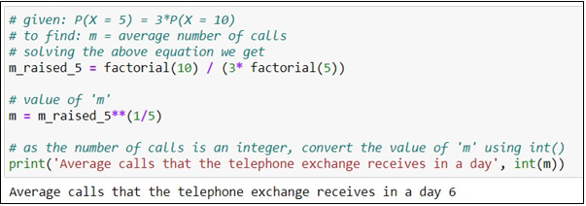
Poisson distribution Python solution:

Slide 51
Summary
Some of the discrete distributions are: Uniform, Bernoulli, Binomial and Poisson
Discrete distribution is determined using probability mass function (p.m.f.)
In uniform distribution, all the values of the variable are equally likely
The sum of independent and identically distributed Bernoulli variables follows binomial distribution
Poisson distribution can be considered as a limiting case of a binomial distribution

Slide 52
Probability distributions
Probability
Distributions
Discrete
Continuous
Uniform
Normal

Slide 53
Continuous probability distribution
It is a probability distribution of the continuous random variable
The continuous distributions are defined by their probability density function (p.d.f.) denoted as f(x)
The probability is given by the area under the pdf on a specified range. Thus, the value of the probability density function is 0 at a particular point
The area under the curve is always equal to 1. Therefore, is considered as a
probability distribution

Slide 54
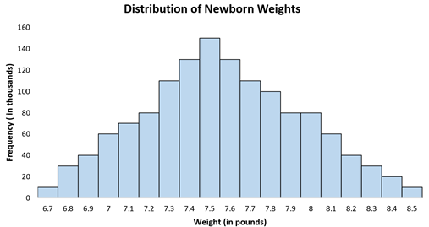
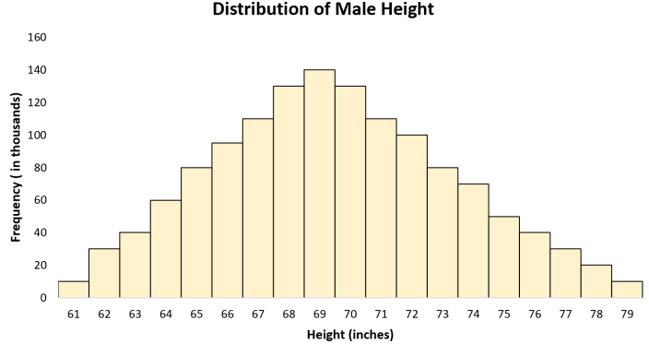
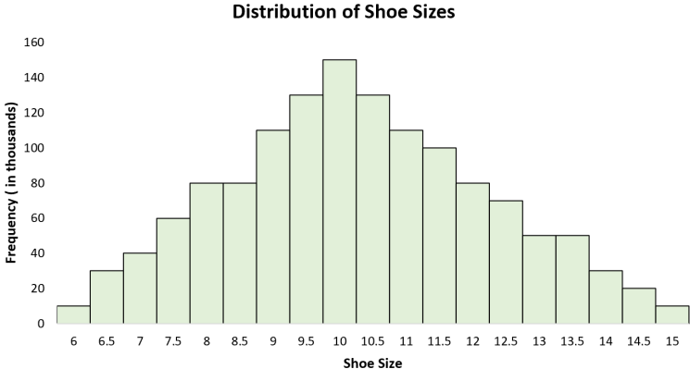
Real-Life Examples of the Normal Distribution
Example 1: Birthweight of Babies:It’s well-documented that the birthweight of newborn babies is normally distributed with a mean of about 7.5 pounds.
Example 2: Height of Males:The distribution of the height of males in the U.S. is roughly normally distributed with a mean of 70 inches and a standard deviation of 3 inches.
Example 3: Shoe Sizes:The distribution of shoe sizes for males in the U.S. is roughly normally distributed with a mean of size 10 and a standard deviation of 1.
Example 6: Blood Pressure:The distribution of diastolic blood pressure for men is normally distributed with a mean of about 80 and a standard deviation of 20.

Slide 55
Normal Distribution

Slide 56
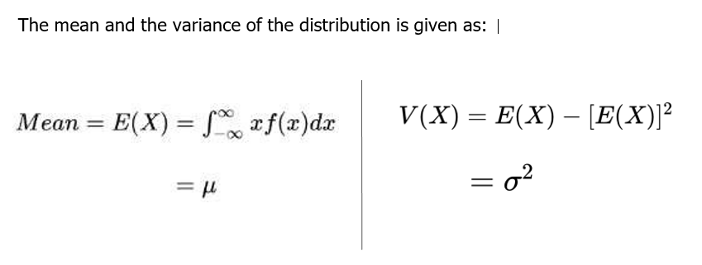
Normal distribution

Slide 57
Normal distribution

Slide 58
Normal distribution - python function
Python function | Description
scipy.stats.normal.pmf() | returns the pmf of discrete normal distribution
scipy.stats.normal.cdf() | returns the cdf of discrete normal distribution
scipy.stats.normal.sf() | calculates the value of survival function (1 - cdf)

Slide 59
Normal distribution
Question:
A monthly balance in the bank account of credit card holders is assumed to be normally distributed with mean $500 and variance $100. What is the probability that the balance can be more than $513.5?

Slide 60
Normal distribution Solution:
Let X: monthly balance in the bank account of a credit card holders X ~ N(𝛍 = 500, σ2 = 100)
To find: the probability that the balance can be more than $513.5 The required probability is P(X > 513.5)

Slide 61
Solution:
We know that for X ~ N(𝛍, σ2), if Z = (x - 𝛍)/σ then Z ~ N(0, 1) that is the standard normal distribution
X ~ N(𝛍 = 500, σ2 = 100) thus Z = (x - 500)/√100 ~ N(0, 1)
The required probability is P(X > 513.5), now becomes

Slide 62
solution

Slide 63
solution
The required probability P(Z > 1.35) = 1 - P(Z ≤ 1.35)
= 1 - 0.9115
= 0.0885
The probability that the balance can be more than $513.5 is 0.0885

Slide 64
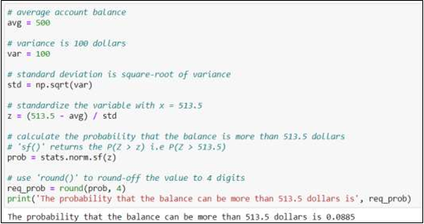
Normal Distribution Python solution

Slide 65
Summary
●Continuous distributions: Uniform and normal
●Continuous distribution is determined using probability density function (p.d.f.)
●The value of pdf at a particular point is always zero
●For a normal distribution, Mean = Median = Mode
●Standard normal distribution has mean zero and variance one

Slide 66
Load the necessary packages
import numpy as np
import pandas as pd
import matplotlib.pyplot as plt
import seaborn as sns
NumPy is a Python library.
NumPy is used for working with arrays.
NumPy is short for "Numerical Python".
Pandas is a Python library.
Pandas is used to analyze data.
Matplotlib is a Python library that helps in visualizing and analyzing the data and helps in better understanding of the data with the help of graphical, pictorial visualizations
%matplotlib inline command before we create the line plot
Seaborn is a library that uses Matplotlib underneath to plot graphs. It will be used to visualize random distributions.
SciPy (pronounced as “Sigh Pi”) is an Open Source Python-based library, which is used in mathematics, scientific computing, Engineering, and technical computing.

Slide 67
numpy.arange([start, ]stop, [step, ], dtype=None) -> numpy.ndarray
start is the number (integer or decimal) that defines the first value in the array.
stop is the number that defines the end of the array and isn’t included in the array.
step is the number that defines the spacing (difference) between each two consecutive values in the array and defaults to 1.
dtype is the type of the elements of the output array and defaults to None.

Slide 68
A pairplot plot a pairwise relationships in a dataset. The pairplot function creates a grid of Axes such that each variable in data will by shared in the y-axis across a single row and in the x-axis across a single column
The distplot represents the univariate distribution of data i.e. data distribution of a variable against the density distribution. The seaborn. distplot() function accepts the data variable as an argument and returns the plot with the density distribution.
Heatmap is a graphical representation of 2D (two dimensional) data. Each data value represents in a matrix and it has a special color. The color of the matrix is dependent on value. Normally, low-value show in low-intensity color and high-value show in hight-intensity color format.

Slide 69
Load the Cardio Dataset
mydata = pd.read_csv('/content/drive/MyDrive/CardioGoodFitness .csv')
from google.colab import drive
drive.mount('/content/drive’)
Mounted at /content/drive

Slide 70
Corr() Corelation The corr () method finds the correlation of each column in a DataFrame.
import pandas as pd
data = {
"Duration": [50, 40, 45],
"Pulse": [109, 117, 110],
"Calories": [409.1, 479.5, 340.8]
}
df = pd.DataFrame(data)
print(df.corr())

Slide 71
pandas.pivot_table(data, values=None, index=None, columns=None, aggfunc='mean', fill_value=None, margins=False, dropna=True, margins_name='All', observed=False, sort=True)
pandas.crosstab(index, columns, values=None, rownames=None, colnames=None, aggfunc=None, margins=False, margins_name='All', dropna=True, normalize=False)
In Python, a crosstab is a tabulation of two different categorical variables. array-like, Series, or list of arrays/Series Values to group by in the rows.
dropna :bool, default True Do not include columns whose entries are all NaN.
aggfunc: function, list of functions, dict, default numpy.mean -> If list of functions passed, the resulting pivot table will have hierarchical columns whose top level are the function names. -> If dict is passed, the key is column to aggregate and value is function or list of functions

